Slide 1
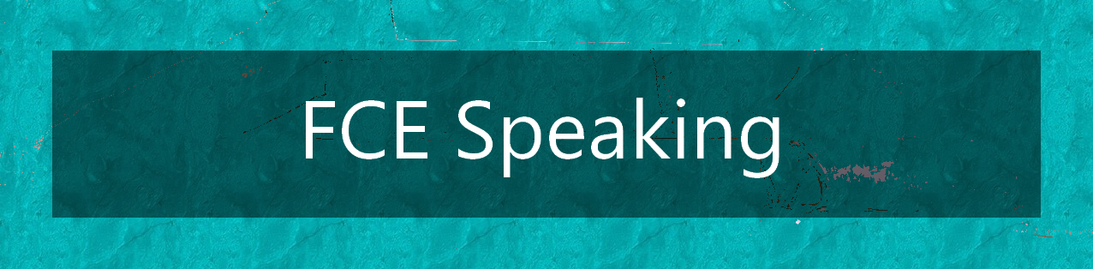
Part 3
Collaborative Task

Slide 2
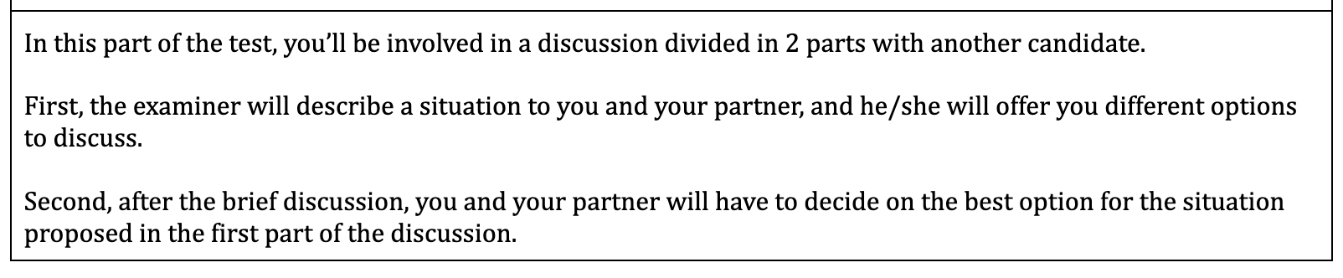
THE TASK
1
DISCUSS THE OPTIONS
2
DECIDE ON ONE OPTION

Slide 3
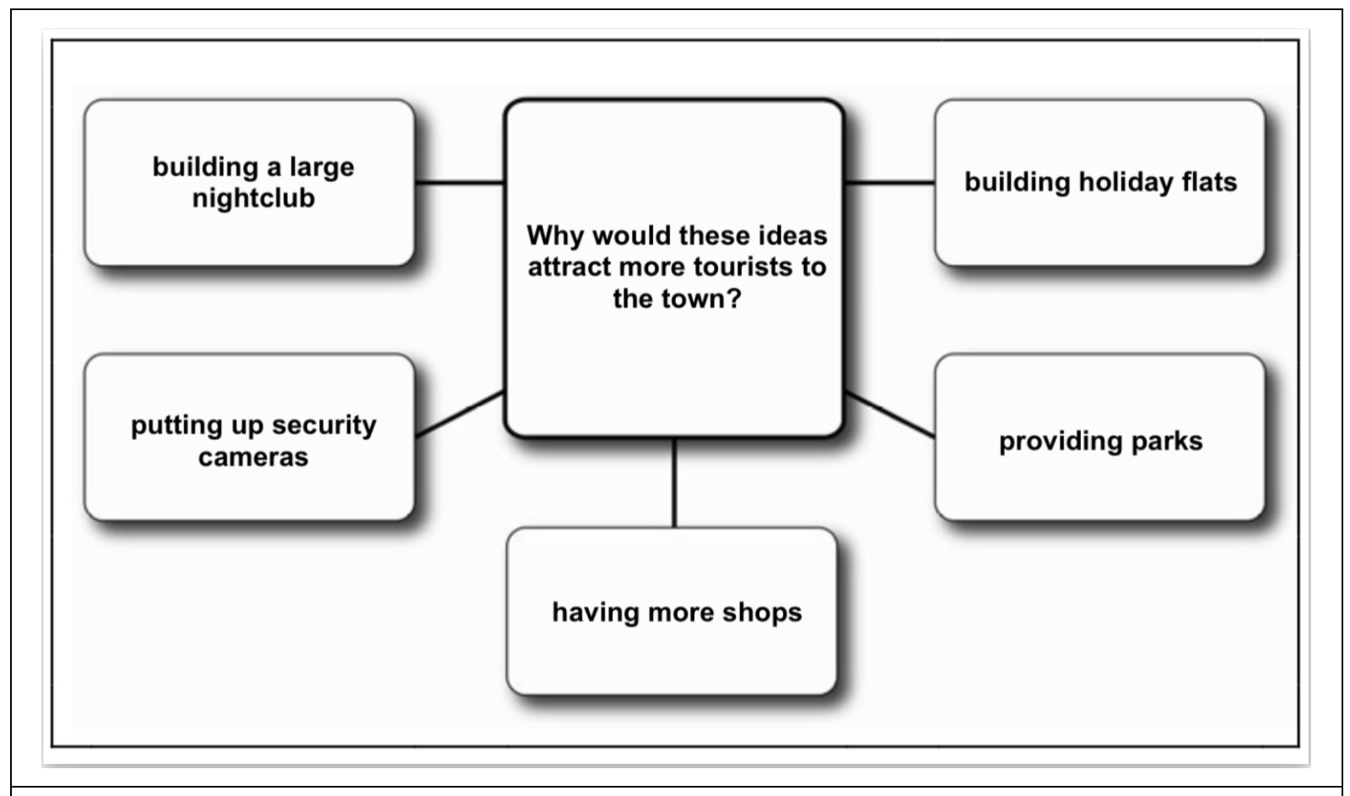
THE TASK
1
DISCUSS THE OPTIONS
You’ll get 15 seconds to familiarise yourself with the task.

Slide 4
THE TASK
2
DECIDE ON ONE OPTION
“Which idea would be best for the town?”

Slide 5

THE TIME
1
DISCUSS THE OPTIONS
2 minutes
2
DECIDE ON ONE OPTION
1 minute

Slide 6
TOP TIPS PART 1
1
2
3
PHRASES TO START
PHRASES TO EXPRESS YOUR OPINION
ASK THE OTHER CANDIDATE’S OPINION
4
AGREE DISAGREE +
COMMENT
5
CHANGE THE SUBJECT

Slide 7
TOP TIPS PART 2
1
2
3
PHRASES TO START
PHRASES TO EXPRESS YOUR OPINION
ASK THE OTHER CANDIDATE’S OPINION
4
AGREE DISAGREE +
COMMENT
5
REACH FINAL DECISION

Slide 8
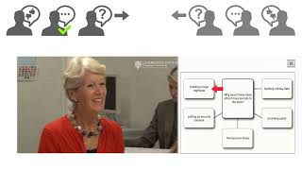
AN EXAMPLE
Remember these candidates may make mistakes, just like anyone else!

Slide 9

AN EXAMPLE
Remember these candidates may make mistakes, just like anyone else!

Slide 10


Slide 11
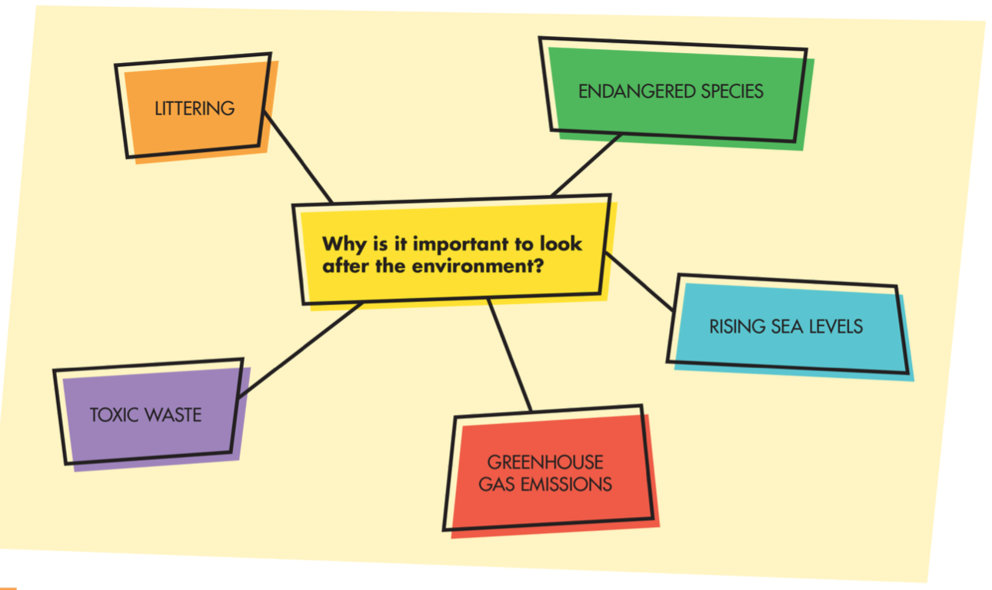

Slide 12
Throwing garbage on the streets, the sea or dumpsters is harmful for our planet.
It can also endanger animals and contaminate their habitats.
LITTERING
Why is it important to look after the environment?
People who litter do not consider the impact it has on future generations.
Non-biodegradable materials can persist in the environment for decades or even centuries.

Slide 13
Global warming and deforestation increase the chances of vulnerable animals to disappear.
Critically endangered species need to find new habitats, face dangers and struggle to find food.
ENDANGERED SPECIES
Why is it important to look after the environment?
At-risk species are part of the ecosystem and all animals play a crucial role in maintaining biodiversity.
Protecting threatened species is paramount to take care of the food chain.

Slide 14
When not properly managed, this particular type of waste can contaminate the soil.
Consequently, plants and animals can be affected.
TOXIC WASTE
Why is it important to look after the environment?
Species are threatened and our very lives as well when we eat meat, fruit and vegetables.
Being exposed to highly toxic chemicals is extremely harmful for our health.

Slide 15
Landfills, coal mining, wastewater treatment and mobile combustion generate methane and carbon dioxide emissions.
By recycling and being aware of our consumption of plastic, we can help put a stop to global warming.
GREENHOUSE GAS EMISSIONS
Why is it important to look after the environment?
Using alternative means of transport will also be helpful to control climate change.
In that way, droughts and floods can be avoided.

Slide 16
Global warming has produced climate change all over the world, creating unexpected droughts and floods.
The economic consequences of property damage can be astronomical.
RISING SEA LEVELS
Why is it important to look after the environment?
It has a major impact on coastal communities, since people have to face displacement.
In the worst case scenario, hundreds or thousands of lives can be lost.

Slide 17
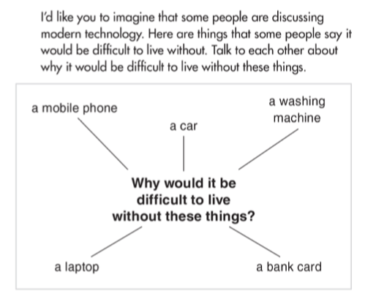

2
CHECK A SAMPLE ANSWER
SB p.251
(Open World B2)
1
PRACTICE
Example
Part 1
Example
Part 2

